Slide 1
VR Classroom

Slide 2
What does it do?
This product is a VR programme that simulates a classroom environment with in-real time avatars of teachers and pupils for people with disabilities that are unable to attend school.
This VR programme allows the people with a disability to attend school and acquire a full education from the comfort of their own homes, and allows them to be in a similar environment as a normal classroom, with professionally trained teachers
This product removes many aspects of the regular school life that provide difficulties for people with disabilities such as wheelchair facilities, special needs assistance, bullying, segregation.

Slide 3

VR Classroom
The VR Classroom removes many distractions in the regular school day, such as weather, traffic and animals. It also removes noise that can occur out in the hallways.
VR Classroom can help to eliminate boredom in the classroom as it is unlike other forms of education it can keep the attention of children for longer than standard methods.

Slide 4
Advantages
VR Classroom is a unique product with a wide market to expand into.
VR Classroom can provide people with an education through all levels of education such as primary & secondary school and college.
Gives people who cannot attend school an opportunity to earn a full education.
The VR Classroom eliminates distance between pupils and their schools and it can eliminate bullying and segregation as people have the ability to create their own personalised avatars.

Slide 5
Disadvantages
The product requires a Virtual Reality headset.
Using a Virtual Reality headset may have some side affects such as nausea and headaches.
Virtual Reality can make people unaware to their surrounding which may provide a danger in some situations.
No hierarchy in the school, only the teacher in the classroom.

Slide 6
VR Classroom Website Design
The design is a prototype and made in photoshop.
Next Slide For Website Image

Slide 7
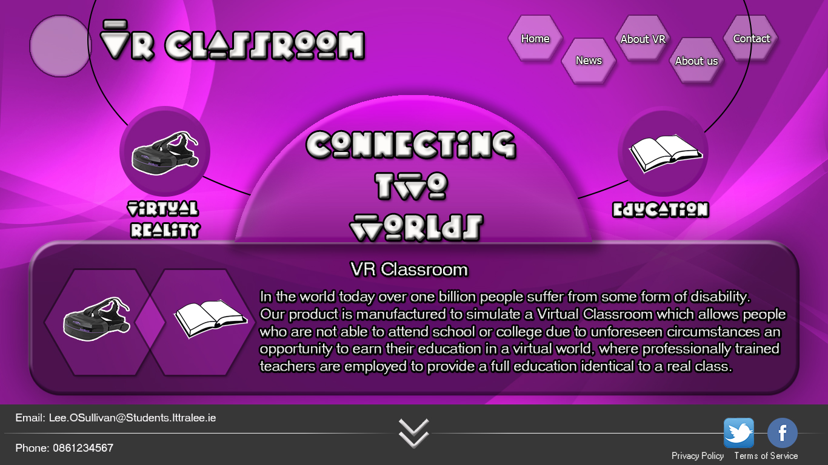
VR Classroom Webiste Design

Slide 8
Survey Analysis
Do you think that every child deserves the right of education?
94% of people who answered said yes.
If you were unable to attend school/college would you be likely to use an alternative method to attend class?
66.67% of people who answered said yes.
Do you think a classroom simulation would be beneficial to people who are unable to attend school or college in the long-term?
64.1% of people who answered said yes.
If you couldn't attend class/lecture would you be likely to use a VR headset to simulate a class/lecture?
46.15% of people who answered said yes and 43.59% said maybe.

Slide 9


